Slide 1

WHEN WE OPEN THE AZAMON THIS SCREEN WİLL WELCOME US.
YOU CAN SEARCH BOOK USING SEARCH BAR, LOOK AUTHOR, VİEW GENRE AND IF YOU WANNA ADD BOOK AND SEE IN YOUR CART YOU MUST LOG-IN.
YOU CAN ADD CARD WITHOUT LOGIN BUT WHEN YOU CLICK BASKET ICON ON THE TOP YOU WILL DIRECTED TO LOG-IN PAGE.
AND YOU DONT NEED TO ADD SAME BOOKS AGAIN YOUR CART BECAUSE YOUR SELECTIONS KEPT IN YOUR SESSION.

Slide 2
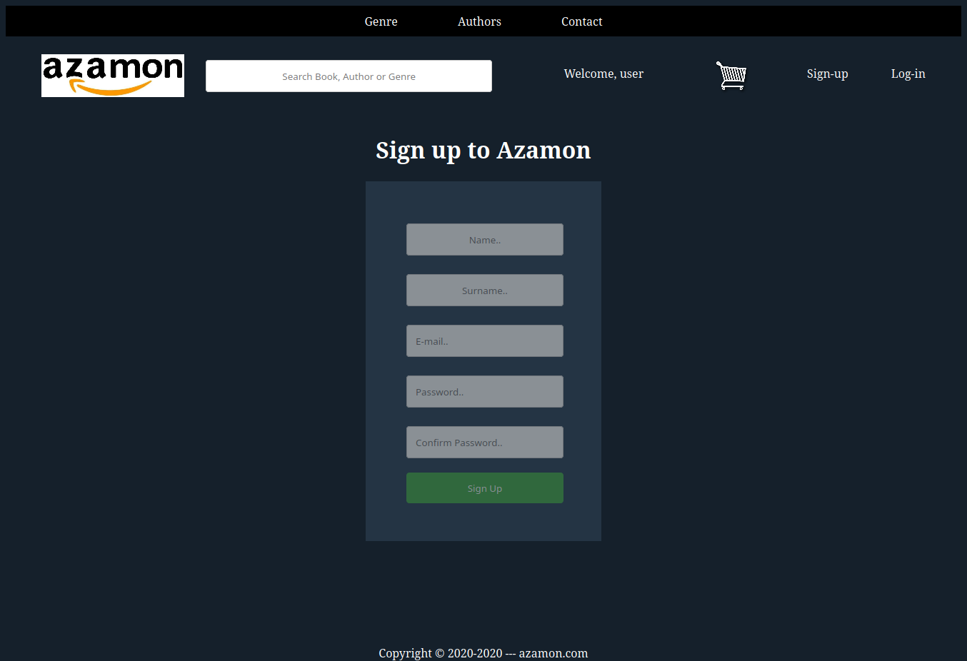
WHEN YOU CLICKED TO SIGN-UP THIS PAGE WILL WELCOME YOU.
YOU MUST FILL ALL OF PLACES OTHERWISE YOUR SIGN-UP WILL FAIL.
E-MAIL CANNOT BE RANDOM IT MUST BE LOOK LIKE THİS: "@xxx.xxx".
Password should be at least 8 characters in length and should include at least one upper case letter, one number, and one special character.

Slide 3
WHEN USER CREATE NEW PROFILE WE CAN SEE THIS REGISTRATİON IN MYSQL DATABASE.
AS YOU SEE, USER PASSWORD ENCRYPTED WITH MD5 ENCRYPTION.

Slide 4
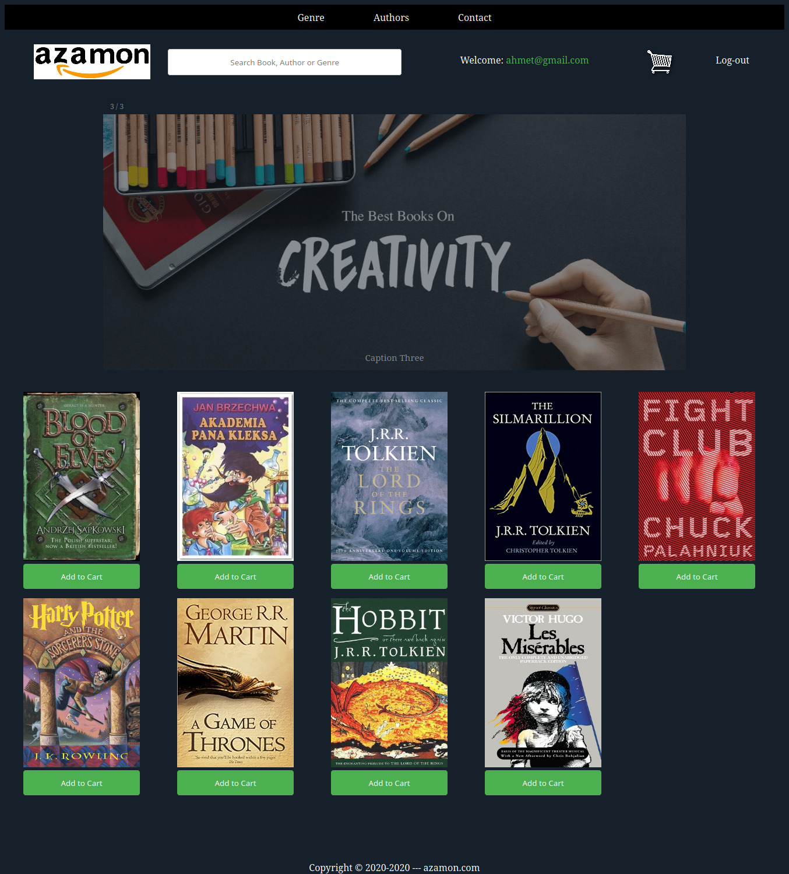
WHEN USER CLİCK LOG-IN AND LOGGED-IN NEARLY SAME PAGE WILL WELCOME US.
AS YOU SEE, USER EMAİL WILL SHOWN IN WELCOME TITLE.
THIS INFO STORED IN SESSION AND I PULL FROM SESSION.
RIGHT NOW WE CAN CLICK TO BASKET ICON AND SEE BOOKS WHICH WE BEFORE CHOOSE.

Slide 5
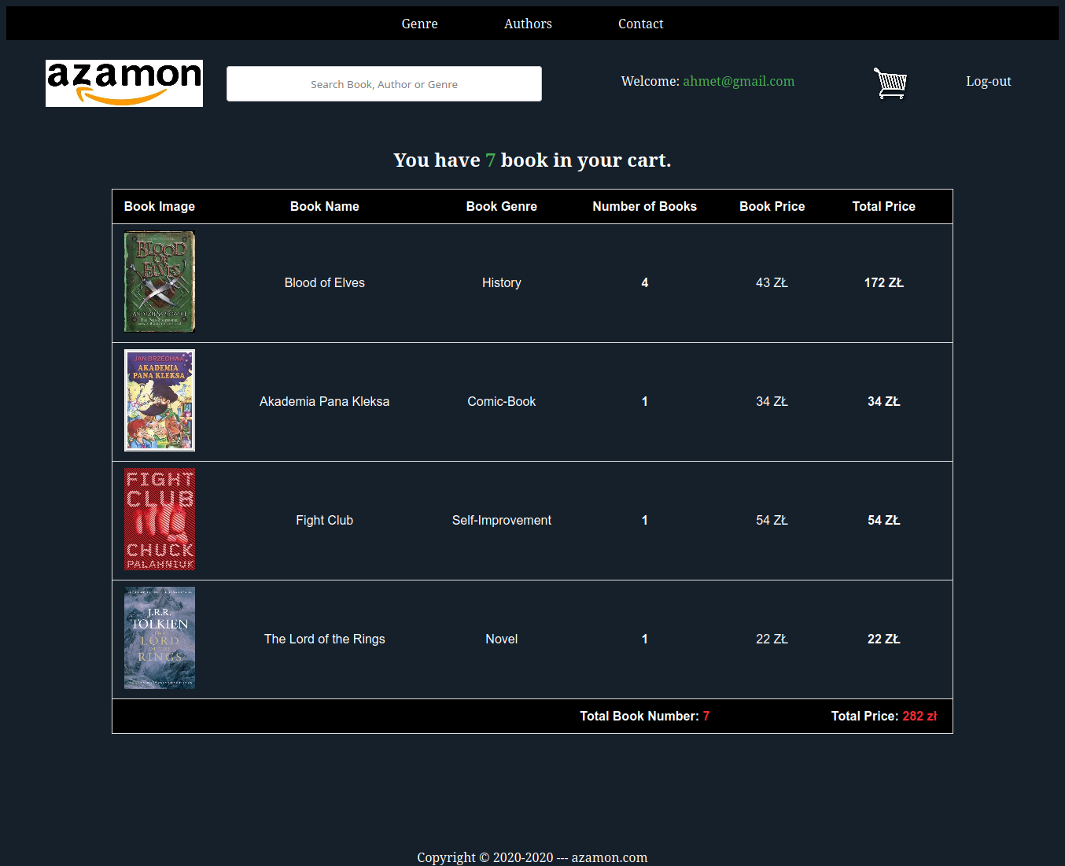
AS YOU SEE WE CAN SEE HOW MANY BOOK WE HAVE TOTALL, HOW MUCH ZL TOTALLY AND HOW MUCH EACH BOOK.
ALSO WE CAN ADD MORE THEN 1 BOOK AND WE CAN SEE HOW MANY SAME BOOK WE HAVE AND THIS SAME BOOKS IS HOW MUCH ZL.

Slide 6
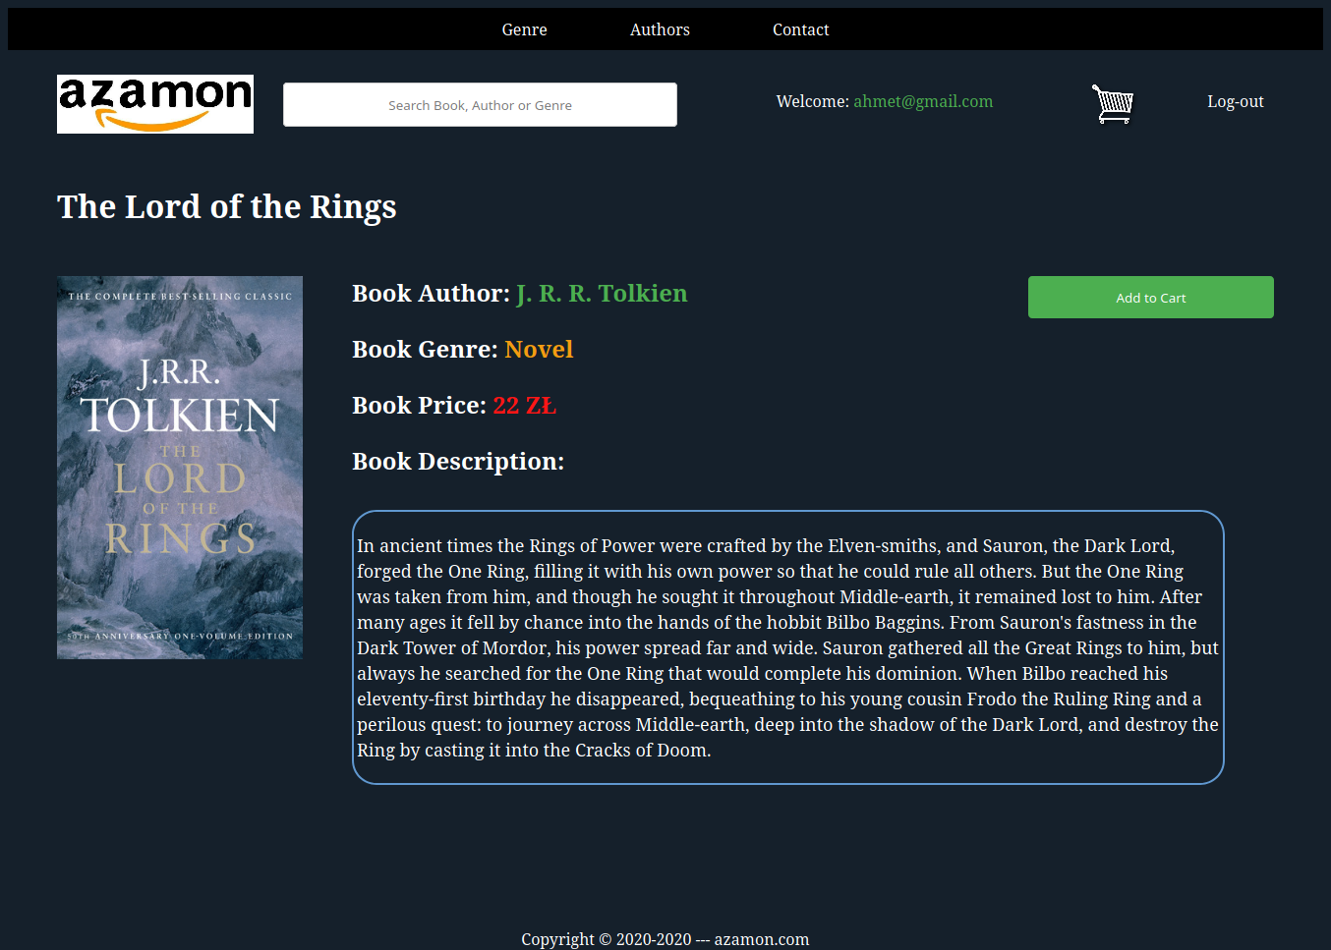
YOU CAN CLICK A BOOK ON THE AZAMON AND YOU CAN READ SHORT DESCRIPTION AND ADD TO CART.
ALSO YOU CAN CLICK BOOK AUTHOR FOR FINDING OTHER BOOKS FOR SAME AUTHOR,
YOU CAN CLICK BOOK GENRE FOR FINFING OTHER BOOKS IN THE SAME GENRE

Slide 7
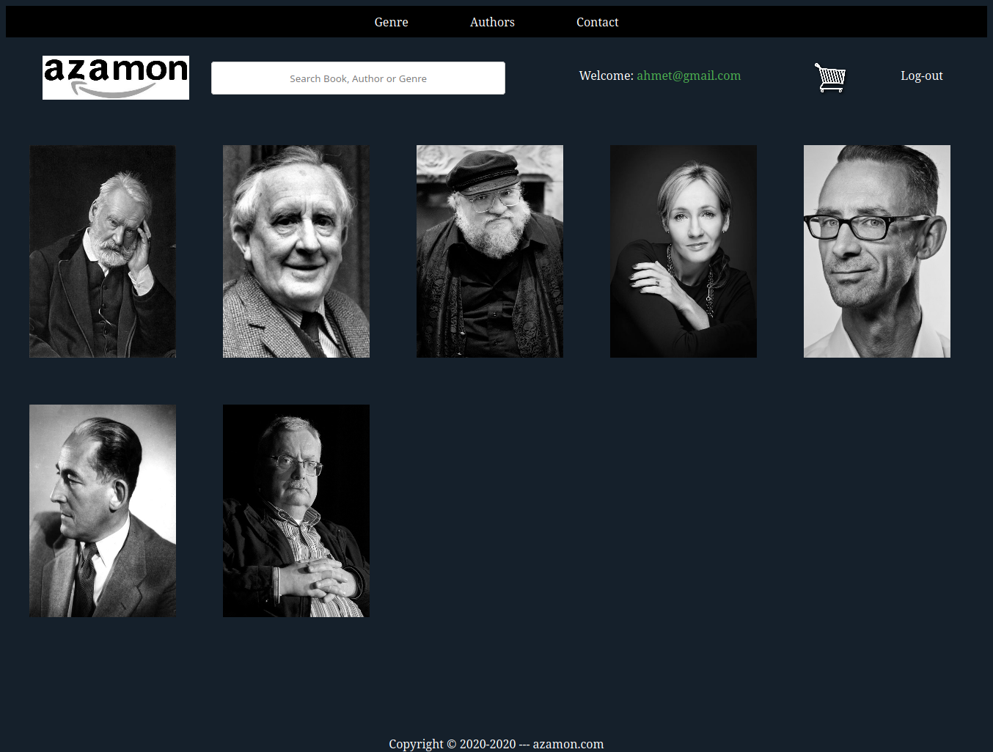
IF YOU CLICK THE AUTHOR SEGMENT YOU CAN SEE ALL AUTHOR ON AZAMON.
YOU CAN CLICK EACH AUTHOR FOR SEEING AUTHOR'S BOOKS.
ALSO I MADE THIS PAGE BLACK/WHITE USING HTML. IT LOOKS MORE COOL

Slide 8
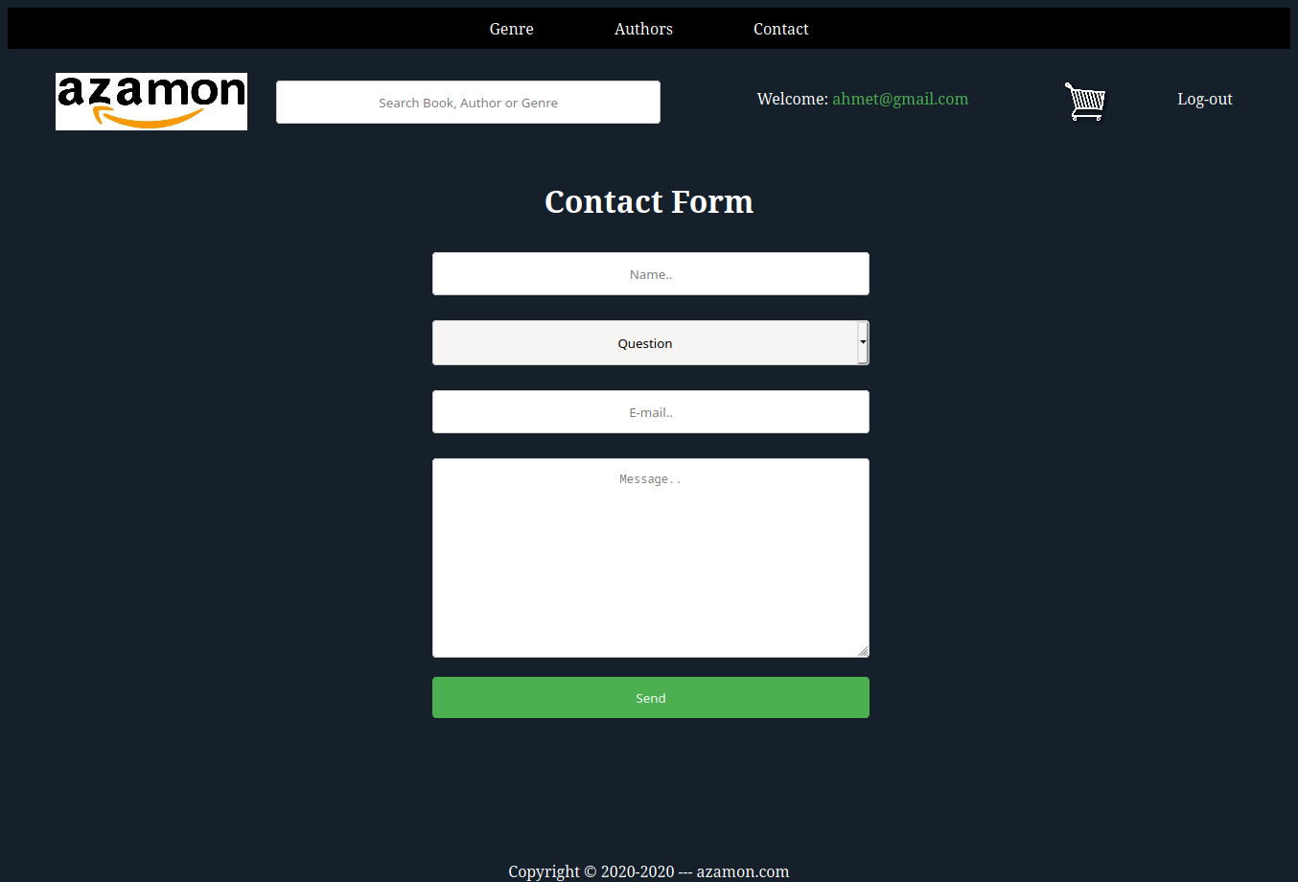
IN THIS PAGE USER CAN CONTACT WITH ME.

Slide 9
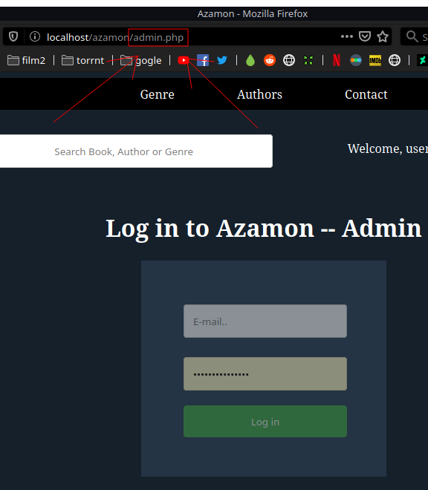
FOR ADMIN LOG-IN YOU MUST WRITE ADMIN.PHP IN THE URL BAR. LATER YOU CAN LOG-IN WITH ADMIN PASSWORD AND E-MAIL.

Slide 10
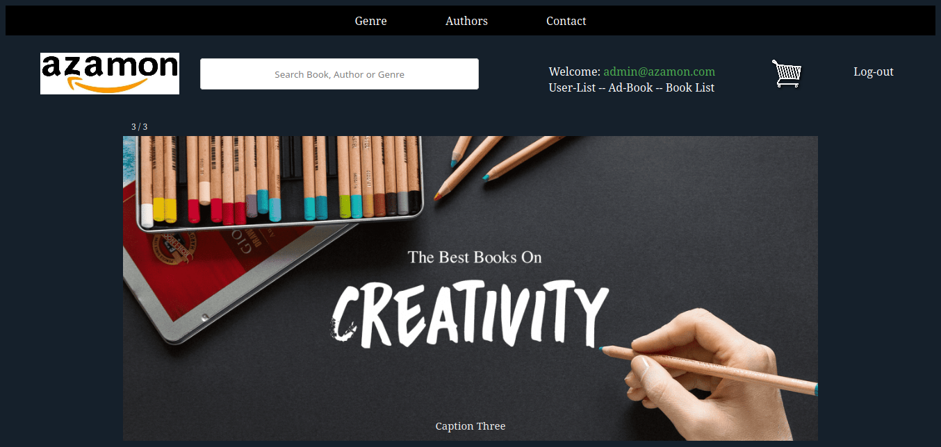
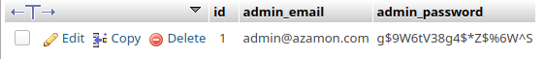
AS YOU SEE WHEN WE LOGGED IN AS A ADMIN OUR WELCOME TITLE CHANGED.
AS A ADMIN WE CAN CHANGE USER INFORMATION, ADD NEW BOOK TO AZAMON, AND CHANGING BOOK INFORMATION ALSO.
ADMIN PASSWORD AND EMAIL STORING IN DIFFERENT TABLE. I DIDN'T MADE MD5 FOR ADMIN RIGHT NOW.

Slide 11
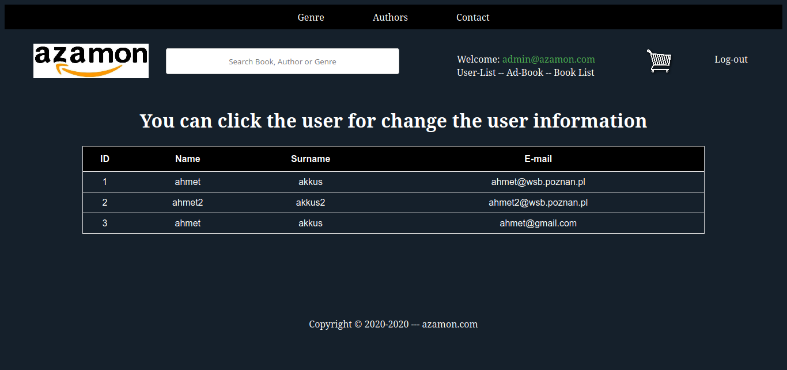
WHEN YOU CLICK THE USER-LIST YOU CAN SEE ALL THE USERS ON THE SYSTEM.
IF YOU CLICK ON IT YOU CAN CHANGE THE USER'S INFORMATION.
FOR EXAMPLE I CLICKED SECOND USER

Slide 12
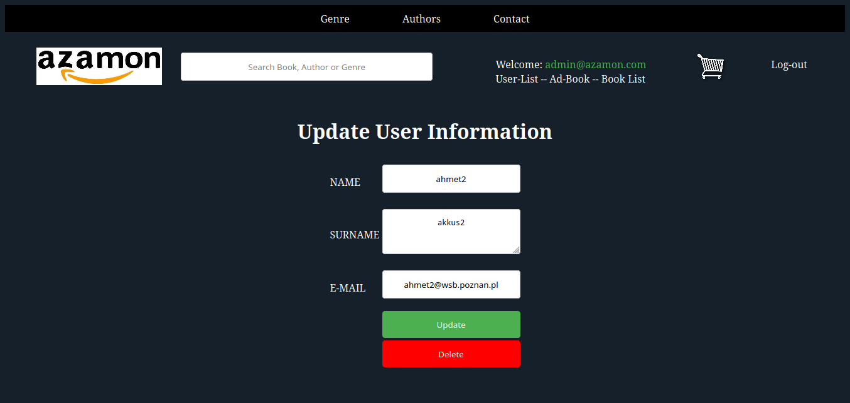
IN THIS SCREEN WE CAN CHANGE SECOND USER'S INFORMATION AS, NAME, SURNAME AND EMAİL
IF YOU WANT YOU CAN DELETE THE USER ALSO.

Slide 13
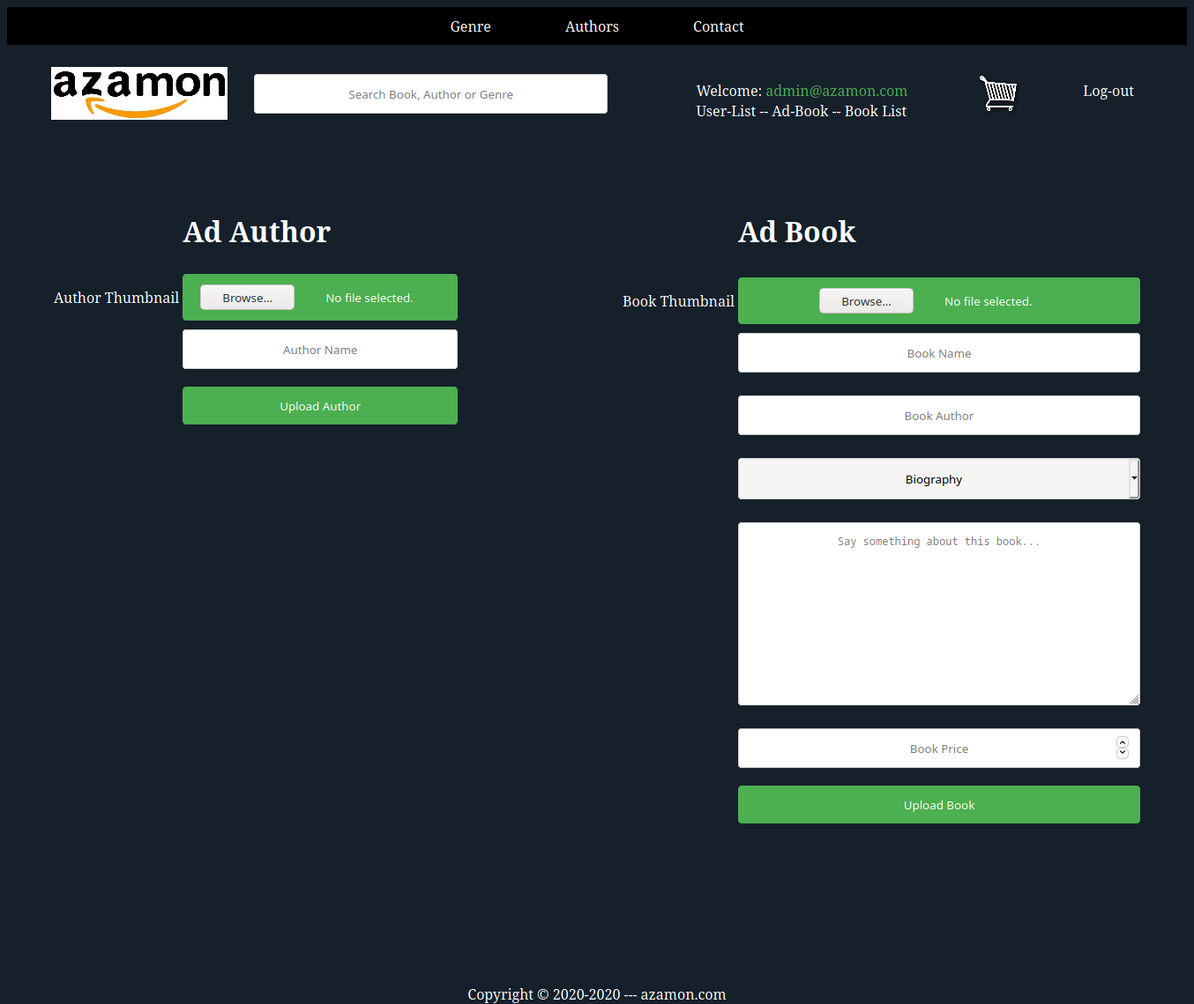
WHEN WE CLICKED THE ADD BOOK SEGMENT WE CAN ADD AUTHOR AND BOOK ALSO.

Slide 14
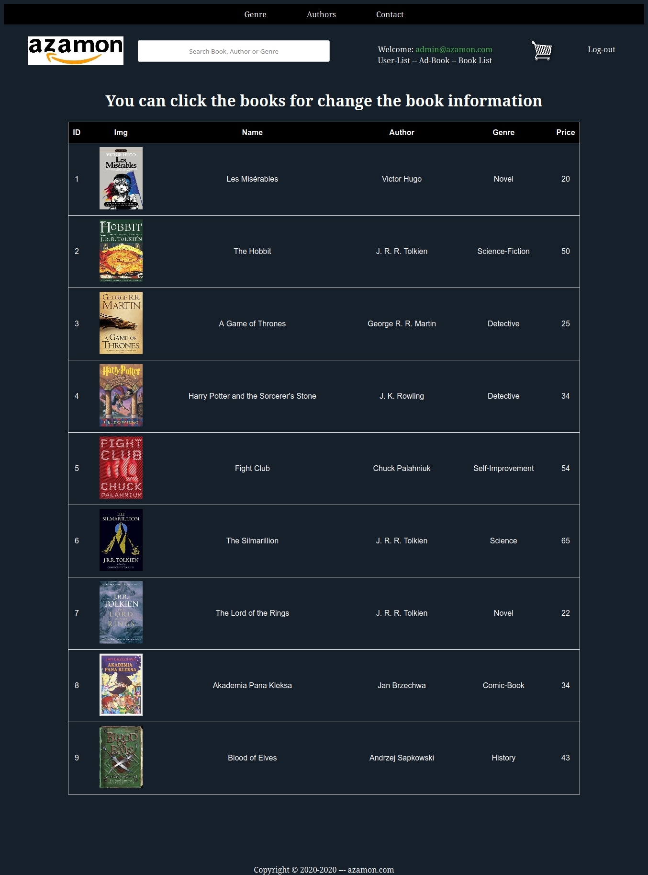
WHEN YOU CLICKED TO BOOK LIST YOU CAN SEE ALL BOOKS ON THE AZAMON.
IF YOU CLICK ON IT YOU CAN CHANGE BOOK INFORMATION
FOR EXAMPLE WE CLICKED ON "Akademia Pana Kleksa"

Slide 15
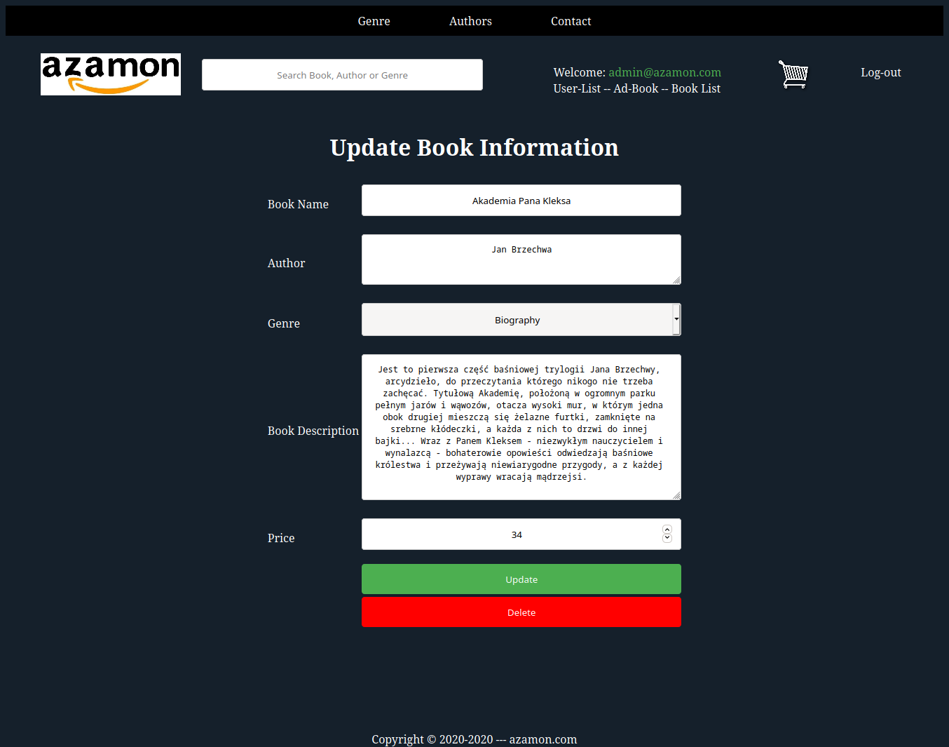
YOU CAN CHANGE MOSTLY EVERYTHING ABOUT BOOK.
AND YOU CAN DELTE IT ALSO.

Slide 16
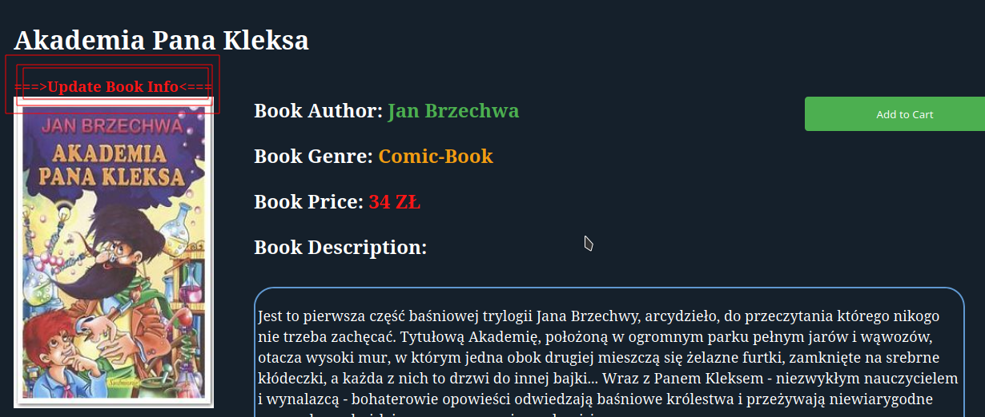
YOU CAN CHANGE BOOK INFORMATION ON THE BOOK PAGE ALSO,
SO YOU CAN JUST SEARCH THE BOOK NAME ON SEARCH BAR LATER GO TO BOOK'S PAGE AND CLICK "UPDATE BOOK INFO" YOU WILL GOING TO PREVİOUS PAGE

Slide 17
YOU CAN CLICK LOG-OUT FOR DESTROY ALL SESSİONS.

Slide 18
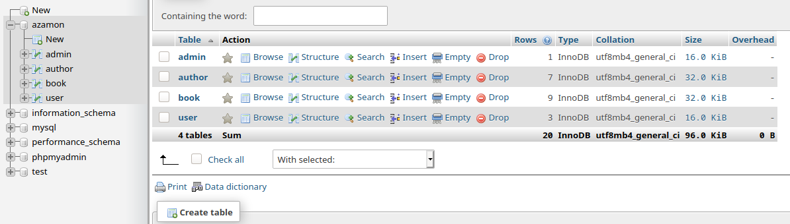
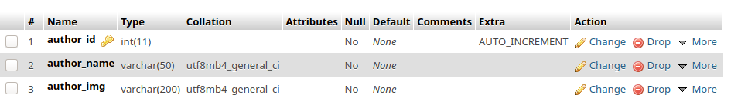
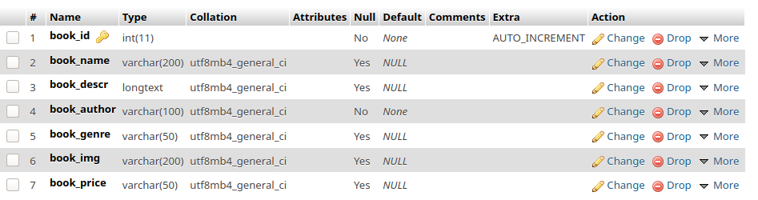
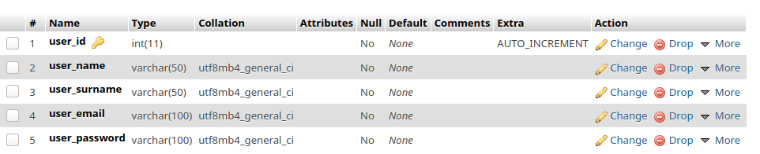
IN HERE YOU CAN SEE MY MYSQL DATABASE
I USED PHPMYADMIN

